Slide 1






ARTIFICIAL INTELLIGENCE
PROJECT
BY RABEEKA YOUSUF

Slide 2
TABLE OF CONTENTS
Introduction
Origins of AI (1940s–1950s)
Symbolic AI & Good Old-Fashioned AI (1956–1970s)
First AI Winter (1970s–1980s)
Machine Learning Emerges (1980s–1990s)
Second AI Winter (Late 1980s–1990s)
Deep Learning Revolution (2010s)
Major Milestones in the 2010s
Foundation Models and Generative AI (2020s)
Emergence of Agentic AI
Challenges and Opportunities
Summary & Closing

Slide 3

INTRODUCTION
This presentation traces the historical and technological journey of Artificial Intelligence.
It explores key milestones, paradigm shifts, and groundbreaking innovations that shaped AI from its inception to the modern era.
We begin by understanding early theoretical concepts and follow the trajectory through symbolic AI, machine learning, and deep learning.
The presentation culminates with the emergence of Agentic AI — systems that possess autonomy, memory, and goal-driven behavior.
Presented by: [Rabeeka Yousuf], [29/6/2025], [GIAIC]

Slide 4

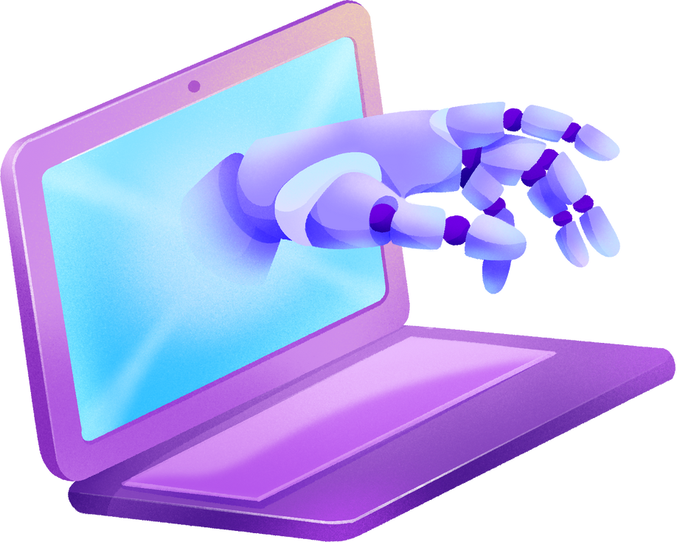
ORIGINS OF AI (1940S–1950S)
1943: McCulloch & Pitts model the first artificial neuron
1950: Alan Turing proposes the Turing Test to evaluate machine intelligence
1956: Dartmouth Conference officially marks the birth of AI
Early AI focused on logic and symbolic processing

Slide 5

SYMBOLIC AI & GOOD OLD-FASHIONED AI (1956–1970S)
01
02
03
04
Rule-based systems were dominant (e.g., SHRDLU, ELIZA)
Logic and symbols used to simulate reasoning
Early successes in math, games, and dialogue systems
Major limitation: systems lacked flexibility in real-world contexts

Slide 6







FIRST AI WINTER (1970S–1980S)
OBJECTIVE 01
OBJECTIVE 02
OBJECTIVE 03
Limited progress led to disappointment
AI systems failed to meet high expectations
Funding reduced by governments and research agencies
.
Hardware and data constraints stalled further development
.

Slide 7



MACHINE LEARNING EMERGES (1980S–1990S)
TRANSITION FROM SYMBOLIC APPROACHES TO STATISTICAL MODELS
IntrODUCTION OF DECISION TREES, SUPPORT VECTOR MACHINES
1986: BACKPROPAGATION POPULARIZED FOR TRAINING NEURAL NETWORKS
REINFORCEMENT LEARNING BEGAN GAINING ATTENTION

Slide 8

SECOND AI WINTER (LATE 1980s–1990s)
Expert systems proved difficult to scale and maintain
Manual knowledge engineering became a bottleneck
Industry disillusionment caused a drop in investment
01
04
02
03

Slide 9
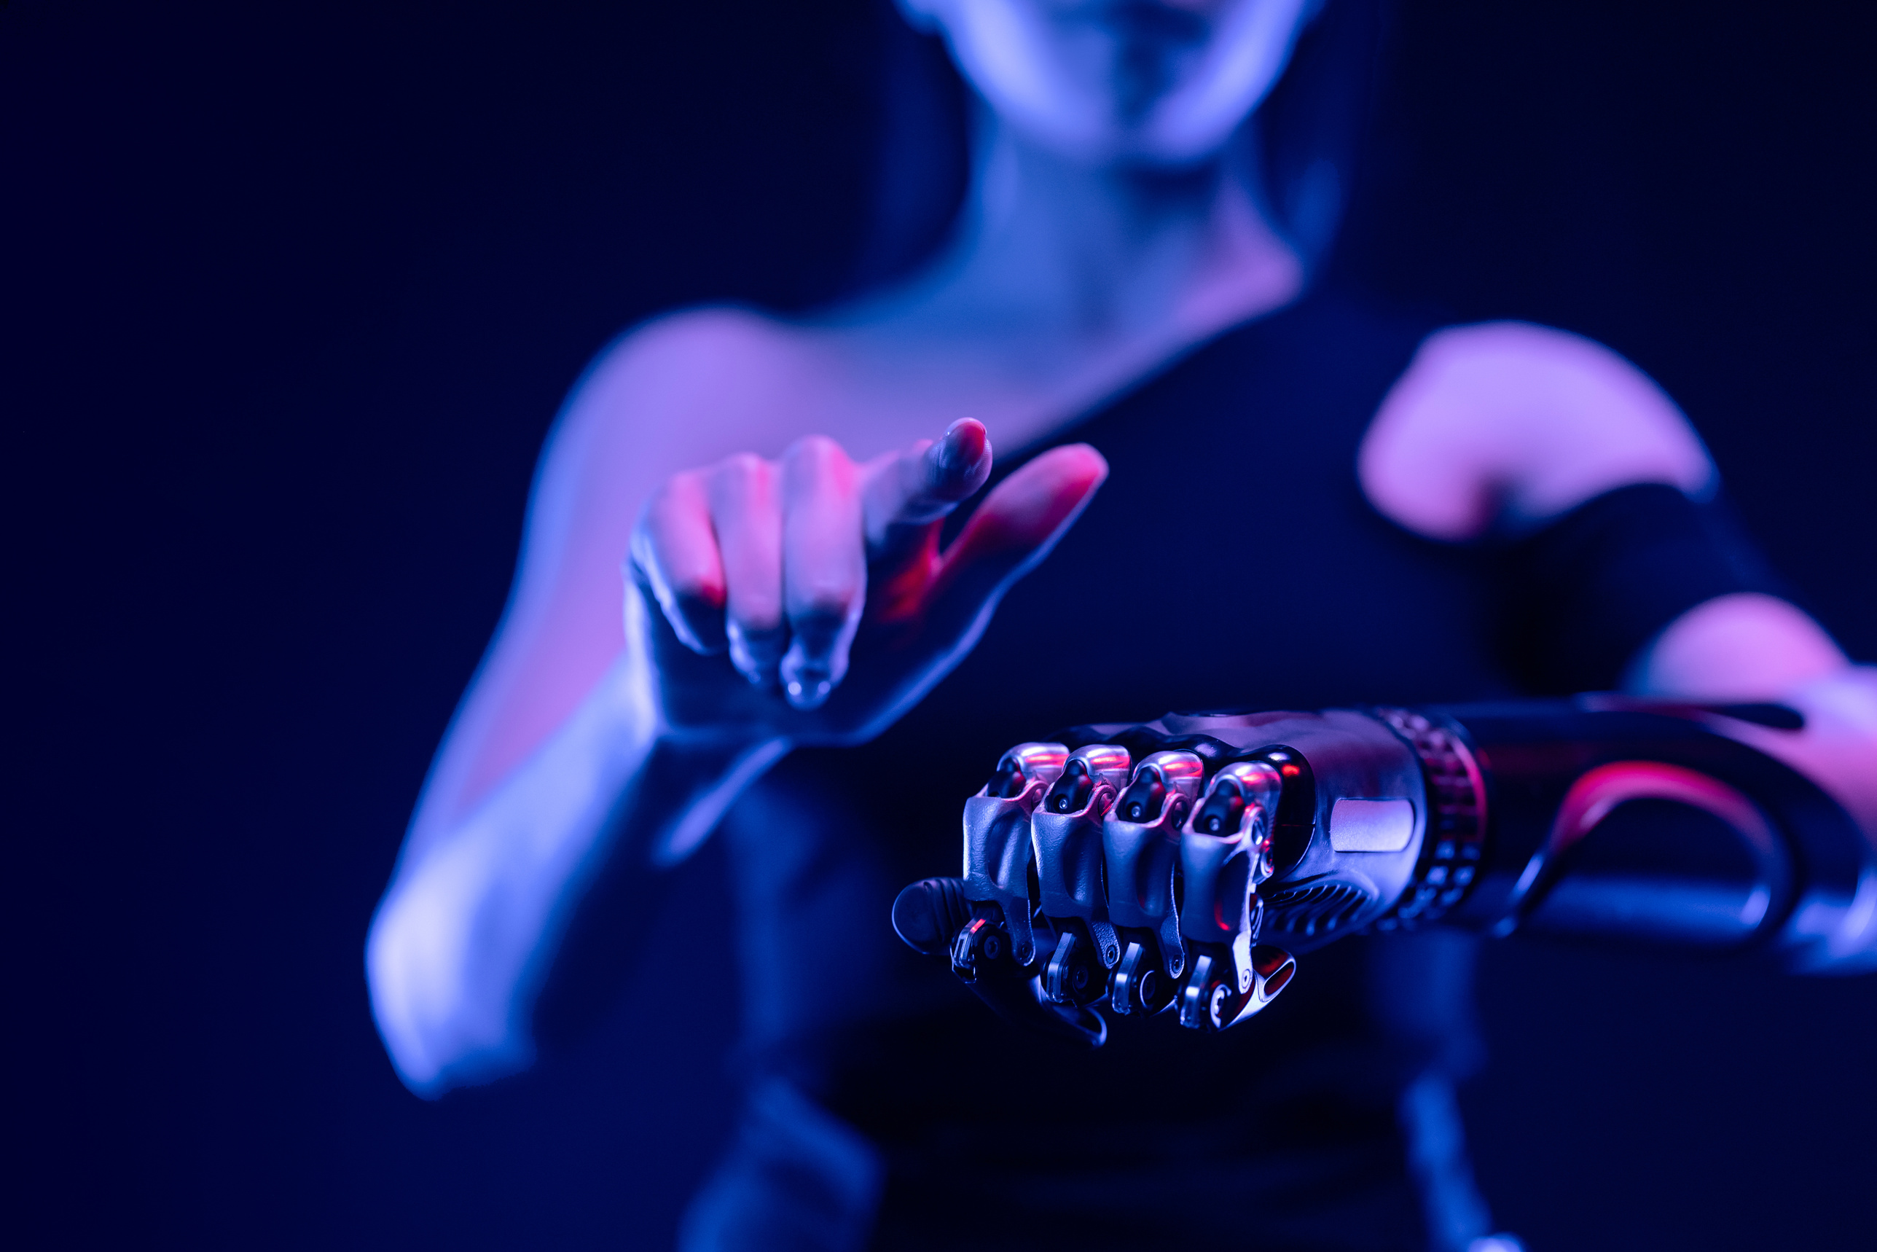
DEEP LEARNING REVOLUTION (2010S)
ARCHITECTURE
2012: AlexNet dramatically improved image recognition performance
GPU acceleration enabled large-scale deep learning
Breakthroughs in computer vision, speech, and language tasks
AI adoption surged in industry and academia

Slide 10




MAJOR MILESTONES IN THE 2010S
2016: AlphaGo defeated world champion Go player Lee Sedol
2018: Introduction of BERT and GPT models in NLP
01
AI applications expanded into healthcare, robotics, and transport
Generative models like DALL·E and CLIP demonstrated creative abilities
02

Slide 11
FOUNDATION MODELS AND GENERATIVE AI (2020S)
Emergence of large-scale language models: GPT-3, PaLM, Claude
Trained on diverse and massive datasets across multiple domains
01
Enabled AI to handle text, image, audio, and code seamlessly
Used for content creation, assistance, and productivity tools
02

Slide 12
EMERGENCE OF AGENTIC AI
AI systems developed the ability to act with autonomy and plan tasks
Tools like AutoGPT, BabyAGI, and Devin show agent-like behavior
01
Capabilities include memory retention, goal-setting, and tool usage
Multi-agent environments used to tackle complex, dynamic challenges
02

Slide 13
CHALLENGES AND OPPORTUNITIES
01
02
03
04
Addressing ethical issues: bias, fairness, accountability
Technical difficulties in ensuring safe and aligned AI behavior
Societal concerns around employment, misinformation, and education
Future focus: global cooperation, regulation, and potential AGI

Slide 14
SUMMARY & CLOSING
AI HAS EVOLVED FROM RULE-BASED SYSTEMS TO AUTONOMOUS AGENTS
KEY TRANSITIONS: SYMBOLIC → STATISTICAL → DEEP LEArnING → AGENTIC
AI CONTINUES TO EXPAND ITS ROLE IN CREATIVITY, AUTONOMY, AND IMPACT
ENCOURAGE AUDIENCE ENGAGEMENT AND OPEN FLOOR FOR QUESTIONS

Slide 15
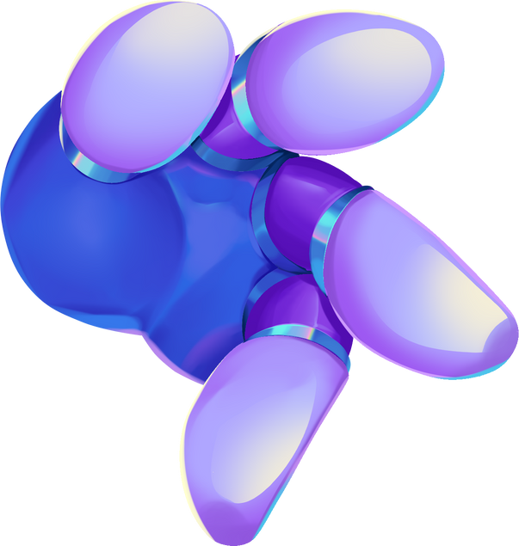
THANK YOU!
PRESENTED BY Rabeeka YOUSUF

